Slide 1





R e s e a r c h S t u d y
Enhancing Code Generation with DSLs and Program Synthesis Techniques
Group 06 (GOAT & LIONS)

Slide 2

R e s e a r c h
Q u e s t I o n :
How can integrating domain-specific languages (DSLs) and program synthesis techniques with user feedback mechanisms enhance the accuracy and usability of ChatGPT for generating application-specific code in productivity software?

Slide 3
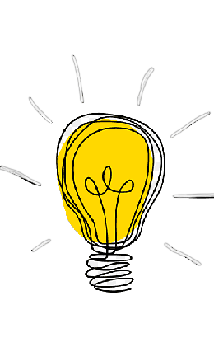
Hypotheses:
a) Domain-Specific Languages (DSLs):
Hypothesis 1: Use of DSLs will facilitate better understanding of user intent and more accurate
customized code generation.
Hypothesis 2: DSLs enable better management of code complexity and error reduction.
b) Program Synthesis Techniques:
Hypothesis 1: Program synthesis techniques can enhance the accuracy of ChatGPT in generating customized code.
Hypothesis 2: Program synthesis enables faster code development and improves work efficiency.
c) User Feedback Mechanisms:
Hypothesis 1: Continuous user feedback integration can improve the quality of the generated code.
Hypothesis 2: User feedback can help in quickly identifying and fixing errors, leading to continuous system improvement.

Slide 4
Faster and More Efficient Software Development:
Improving Accuracy and Usability:
Enhancing ChatGPT’s ability to generate precise and usable code optimizes productivity software workflows.
DSLs and synthesis techniques reduce development time and minimize errors.
Importance of the
Research Question
Enhanced User Experience:
Technological Innovation:
Continuous feedback loops ensure the system evolves according to user needs.
This research can lead to new tools merging AI and program synthesis, broadening the capabilities of automated systems.

Slide 5












Our Tools
Jigsaw
ODSL

Slide 6
Tools Used:
ODSL: (Office DSL) A domain-specific language for office productivity tasks.
Jigsaw Tool: A tool designed for synthesizing DSLs for data manipulation using pandas.
Python Libraries: `python-pptx` for generating presentations, &#39;OpenAI&#39; for integrating with ChatGPT.
Datasets: Custom datasets for testing DSL commands and their effectiveness.

Slide 7
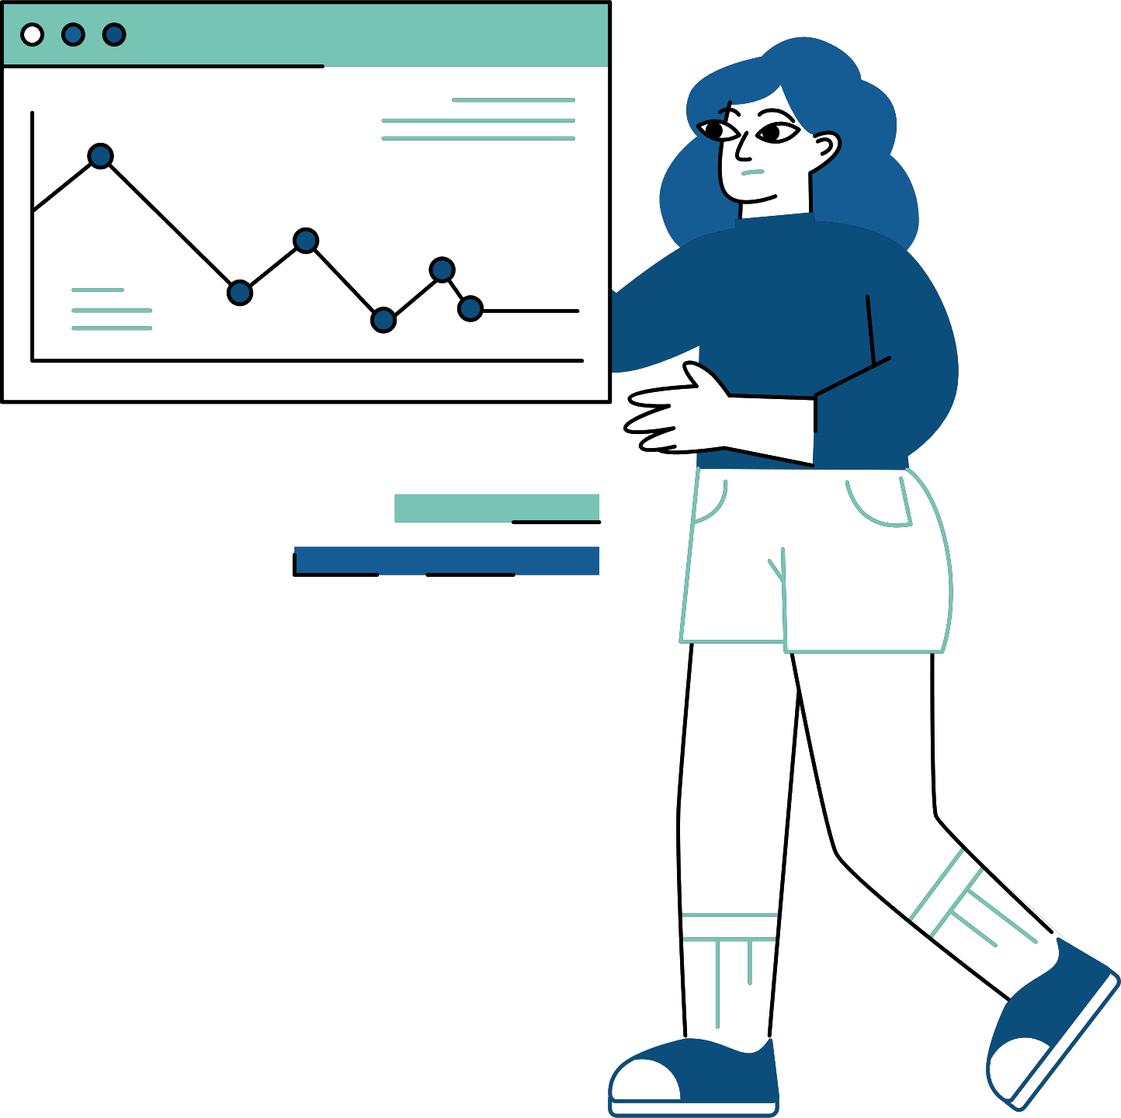
Solution Design:
The solution integrates DSLs and program synthesis techniques with ChatGPT. ODSL and Jigsaw Tool are used to generate commands based on natural language inputs. User feedback is continuously integrated to refine the generated code.

Slide 8
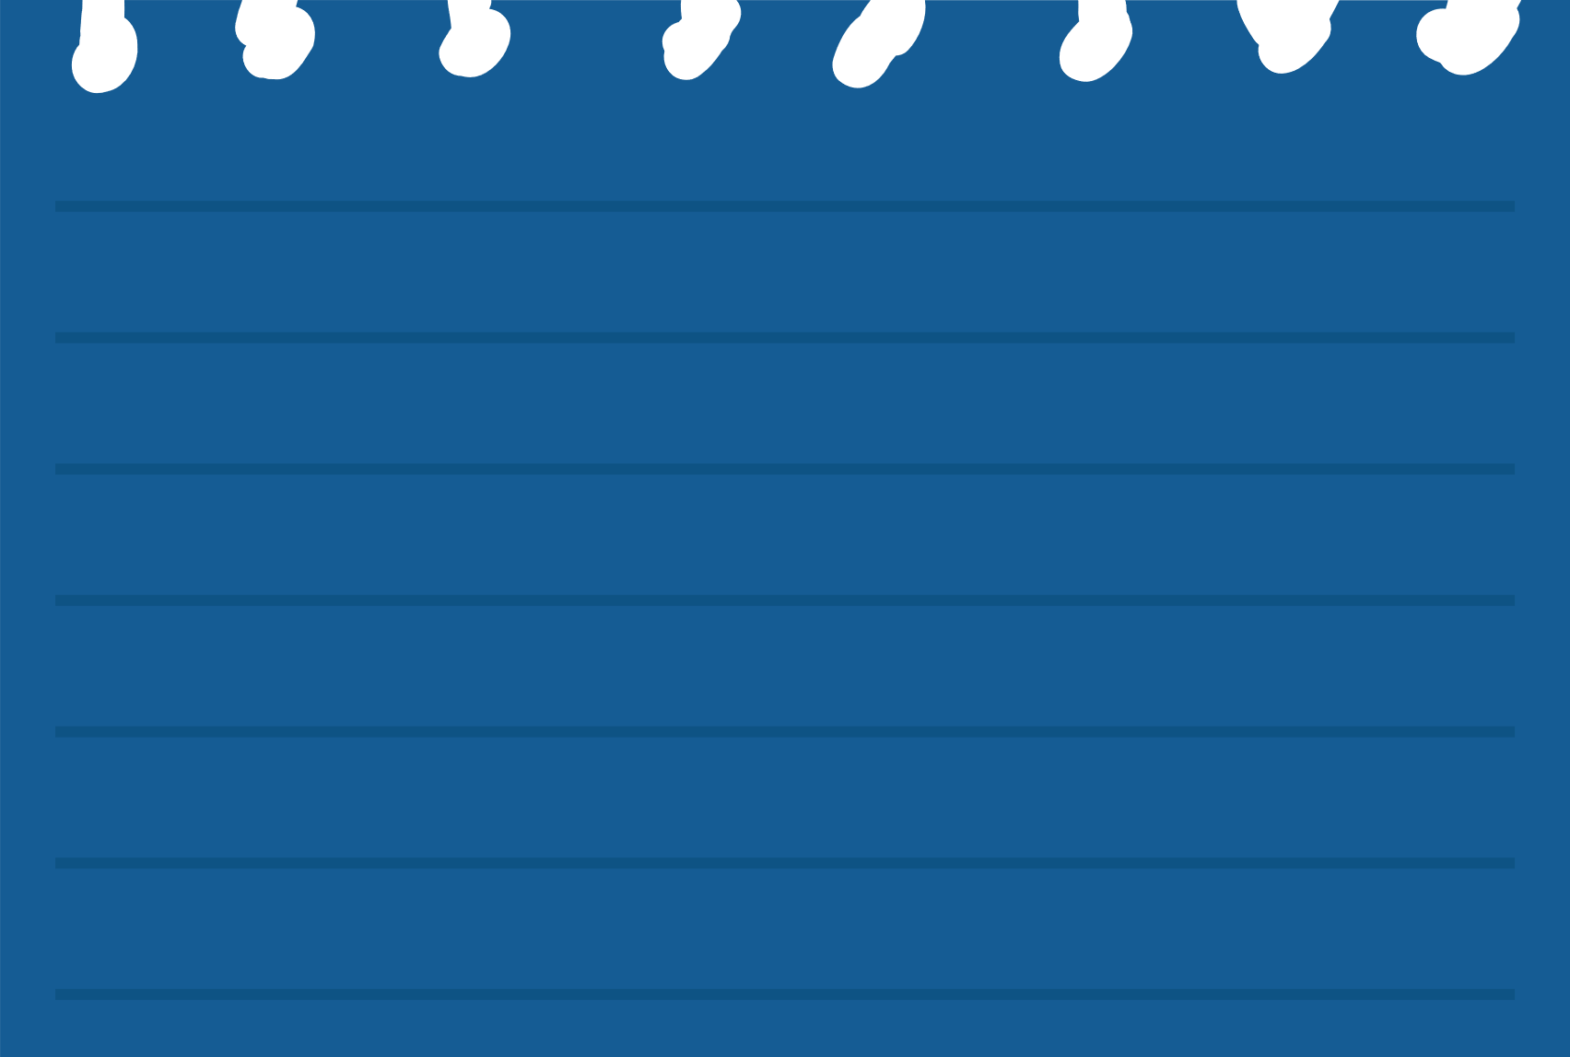

Challenges and Solutions:
Challenge A:
Challenge B:
Challenge C:
Accurately translating natural language into DSL commands.
Managing the complexity of generated code.
Incorporating user feedback effectively.
Solution A:
Solution B:
Solution C:
Using program synthesis techniques to interpret user intent.
Employing DSLs to abstract common tasks and reduce errors.
Implementing a feedback loop to iteratively improve the system.

Slide 9




The example dataset includes DSL commands and the corresponding natural language prompts, which guide the creation and manipulation of presentation slides.
Dataset Presentation & Preprocessing:

Slide 10

import openai
import os
from pptx import Presentation
from pptx.util import Inches
from ast import literal_eval
# Set up your OpenAI API key from environment variable
openai.api_key = os.getenv('OPENAI_API_KEY')
class OfficeDSL:
def __init__(self):
self.prs = Presentation()
self.commands = []
def create_slide(self, layout="Title and Content"):
slide_layout = self.prs.slide_layouts[1] if layout == "Title and Content" else self.prs.slide_layouts[0]
self.prs.slides.add_slide(slide_layout)
self.commands.append(f"create_slide(layout='{layout}')")
print(f"Creating slide with layout: {layout}")
def add_text(self, slide_index, text, placeholder="body"):
slide = self.prs.slides[slide_index]
if placeholder == "title":
slide.shapes.title.text = text
else:
for shape in slide.shapes:
if not shape.has_text_frame:
continue
if shape.text_frame is not None:
shape.text_frame.clear()
shape.text_frame.text = text
break
self.commands.append(f"add_text(slide_index={slide_index}, text='{text}', placeholder='{placeholder}')")
print(f"Adding text '{text}' to slide {slide_index} in placeholder '{placeholder}'")
def add_bullets(self, slide_index, bullets, placeholder="body"):
slide = self.prs.slides[slide_index]
for shape in slide.shapes:
if shape.has_text_frame:
if placeholder == "body" and shape != slide.shapes.title:
shape.text_frame.clear() # Clear existing text
for bullet in bullets:
p = shape.text_frame.add_paragraph()
p.text = bullet.strip()
p.level = 0
break
self.commands.append(f"add_bullets(slide_index={slide_index}, bullets={bullets}, placeholder='{placeholder}')")
print(f"Adding bullets '{bullets}' to slide {slide_index} in placeholder '{placeholder}'")
def save_presentation(self, filename):
self.prs.save(filename)
print(f"Presentation saved as {filename}")
Integrating DSLs and Program Synthesis with ChatGPT

Slide 11

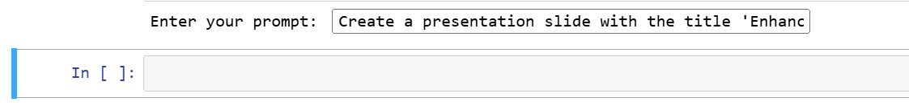
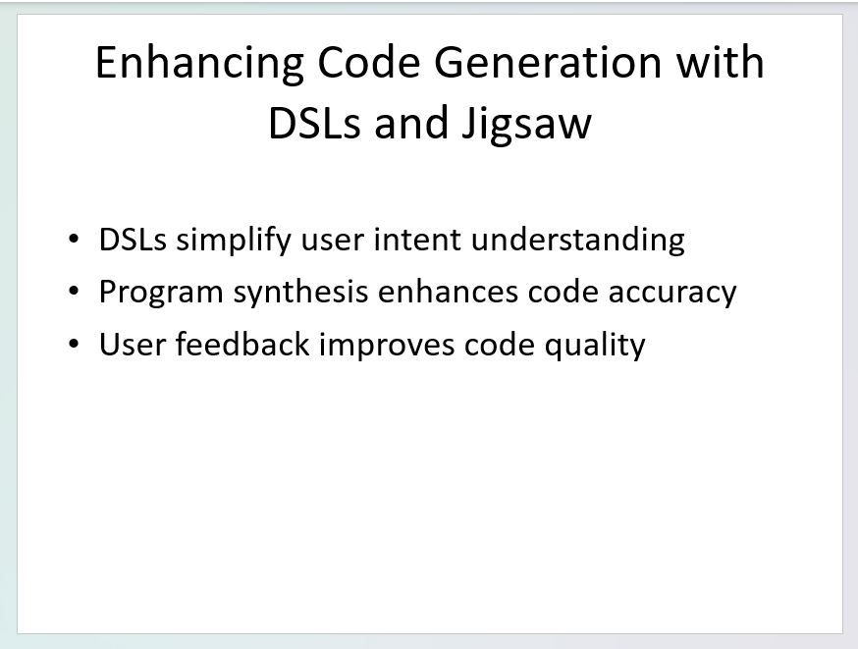

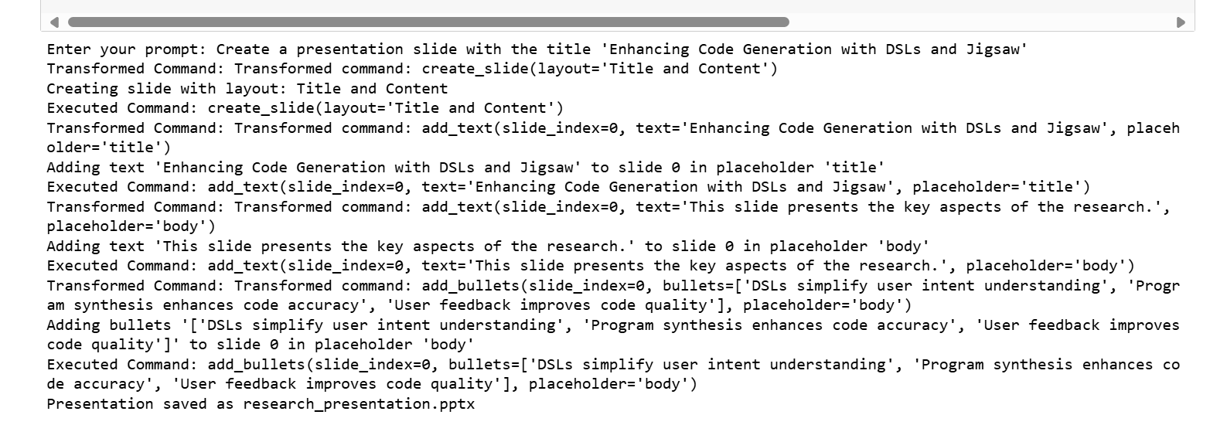
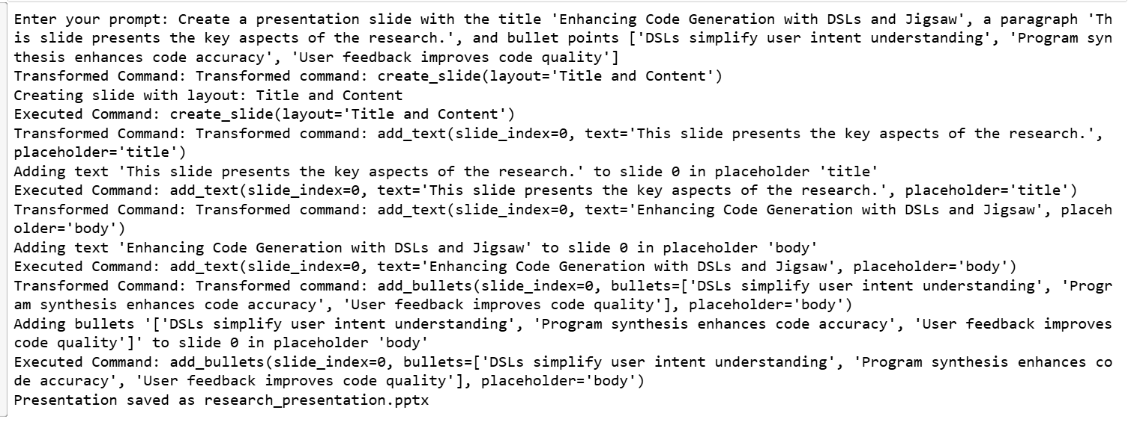
Initial Results:
Generated Presentation Slide
Prompt: "Create a presentation slide with the title 'Enhancing Code Generation with DSLs and Jigsaw', a bullet points ['DSLs simplify user intent understanding', 'Program synthesis enhances code accuracy', 'User feedback improves code quality']"
the output details, the steps taken by the code to generate the slide based on the provided prompt:

Slide 12


Conclusions Addressing the Research Question:
The example demonstrates how integrating DSLs and program synthesis techniques enhances the usability and accuracy of ChatGPT in generating application-specific code for productivity software. The process involved:
Creating a Slide with a Specific Layout:
The DSL command create_slide(layout='Title and Content') specified the creation of a new slide with the
3. Adding Bullet Points to the Slide:
The command add_bullets(slide_index=0, bullets=['DSLs simplify user intent
understanding’, 'Program synthesis enhances code accuracy', 'User feedback improves
code quality'], placeholder='body') added the specified bullet
points to the slide. The use of a list allowed the command to handle multiple
bullet points effectively.
2. Adding a Title to the Slide:
The command add_text(slide_index=0, text='Enhancing Code Generation with DSLs and
Jigsaw', placeholder='title’) added
the title "Enhancing Code Generation
with DSLs and Jigsaw"

Slide 13


Work Process:
1
2
3
Implementing the DSL for presentation manipulation.
Developing the transformation logic to convert natural language input into DSL commands.
Integrating user feedback mechanisms to refine the generated commands.

Slide 14

- Determine research question.
Ensuring accurate mapping of natural language to DSL commands.
Handling complex and multiline inputs in DSL commands.
Challenges:
The importance of clear and concise DSL design for better usability.
The value of user feedback in improving the system's accuracy and adaptability.
Lessons Learned:

Slide 15
General Conclusion:
Combining DSLs, program synthesis techniques, and user feedback mechanisms can significantly enhance the capabilities of ChatGPT in generating custom code for productivity software.

Slide 16


Strengths & Limitations
Strengths:
Improved accuracy, reduced development time, and enhanced user experience.
Limitations:
Handling highly complex natural language inputs may require further refinement of the transformation logic.

Slide 17
Expanding the DSL to cover more functionalities.
Enhancing the transformation logic to handle a wider range of natural language inputs.
Implementing more sophisticated user feedback mechanisms to further improve the system's adaptability.
Future Improvements

Slide 18

THANK YOU VERY MUCH!
Any Questions?

